Slide 1
Total Knee Replacement
Pre-Surgery Class
Molly Sieffert BSN, RN
Orthopedic Nurse Navigator

Slide 2
Virtual Class Reminders
Please keep your microphones muted until we break for questions
Please type your questions in the chat box and I will answer them at the end of the class
You can find the Knee Book, these slides, nerve block video and a class video on our website TrinityHealthMichigan.org/ortho-help

Slide 3
Class Objectives
The purpose of this presentation is to:
Help you to feel more comfortable about your upcoming hospitalization
To let you know what you can do to help in your own recovery

Slide 4

Michigan Arthroplasty Registry Collaborative Quality Initiative - MARCQI
Your surgeon participates in MARCQI which tracks patients for quality improvement purposes
Michigan hospitals and orthopedic surgeons working together to reduce complications and improve your recovery
You will be asked to complete surveys before surgery and after surgery at multiple intervals from 2-16 weeks, 1, 2, 5, and, 10 year intervals.
The survey can be completed by e-mail or in your surgeon’s office during your appointment
If you have provided your email address, you will receive an email from marcqi@mailer.ortechsystems.com with instructions for completing the questionnaire via email

Slide 5
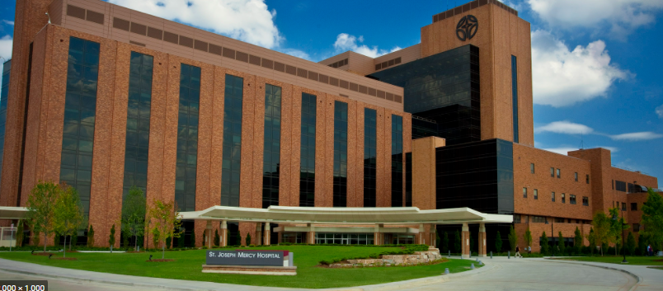
Preparing For Your Surgery

Slide 6
Selecting Your Joint Coach
What?
A coach is a person who can help support you in your recovery at the hospital and at home.
Who?
A coach can be anyone: a spouse, a family member, a friend or a companion.
Why?
A coach is someone that will help you stay motivated and succeed. We all need encouragement at times to help us along the way. Your coach can provide this encouragement for your just by being present and participating in your therapy both at the hospital and after your discharge.
Expectations?
Attend at least one physical therapy session in the hospital. Assist with your needs after discharge.

Slide 7
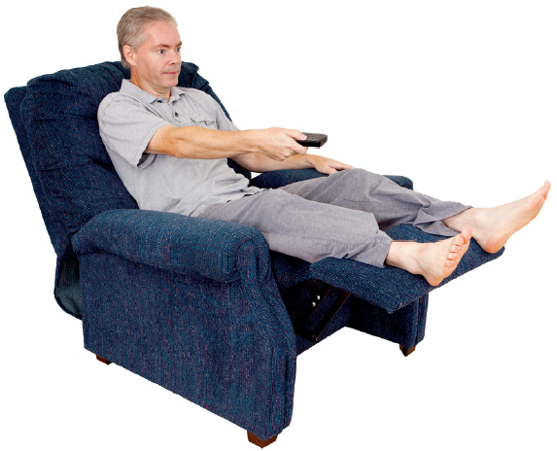
Tips for Preparing your Home
You and your family must consider these tips before your surgery to help make your home as safe and comfortable as possible for your return after surgery:
Check every room for tripping hazards. Remove throw rugs and secure cords
Arrange furniture to have unobstructed pathways while using walker
Move items in lower drawers to height to eliminate excessive bending or reaching
Plan on having a cordless phone or cell phone close by
Make sure stairs have handrails that are securely fastened to walls
In homes with steep long stairs, you may need a bed, portable toilet on first level
If you have pets, try to keep them away from your incision while healing
A chair with a firm back and arm rests is recommended, NO chairs on wheels
Prepare or purchase meals ahead of time to minimize cooking after surgery
Install night lights in bathrooms, bedrooms, and hallways
Get a non-slip bathmat
Put clean linens on your bed

Slide 8
What to Bring with You
If you have Advance Directives please bring them with you
Personal care items
Slippers (that cover your whole foot) – your leg/foot will be swollen following surgery so make sure they are not tight
Clothes -Loose pants/shorts, T-shirt/top. We want you to get dressed
Please do not bring your own pillow
If you use a CPAP machine at home bring it with you, we have distilled water in the hospital for you to use.
Driver’s license, Insurance Cards and a check or credit card to pay for home medical equipment

Slide 9
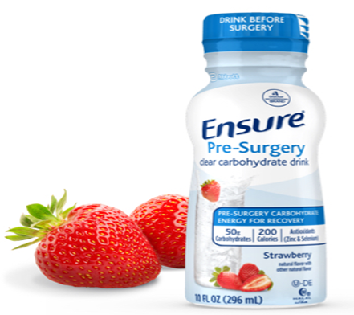
Enhanced Recovery Program
Ensure Pre-Surgery clear nutrition drink is a carbohydrate rich beverage with added supplements that you will drink in the morning on the day of your surgery
Use of Ensure Pre-Surgery Improves:
Comfort
Hydration
Hunger
Thirst

Slide 10
Enhanced Recovery Program
Ensure Pre-Surgery is available for purchase at the pharmacy in the Reichert Health Building- approx. $4 for 1 bottle
You will need to purchase 1 bottle
You need to ask for the Ensure Pre-Surgery at the pharmacy counter
If you have Diabetes, Do not drink the Ensure
Pre- Surgery

Slide 11
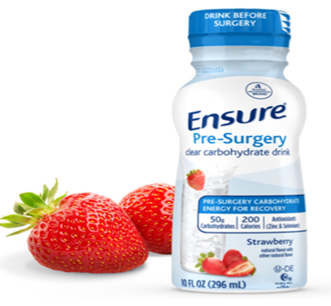
Ensure Pre-Surgery- When to Drink
Finish drinking your Ensure Pre-Surgery 2 hours before your surgery time
If you have diabetes, do not drink the
Ensure- you will be given different
instructions at your pre admission
appointment

Slide 12
Reducing Risks and Complications
Stay active – Exercises for before your surgery are in your book and will be explained further by PT
Healthy diet - Before your surgery, avoid foods that increase inflammation in your body. Those foods include sugar and white flour; saturated fats from red and organ meat; trans fats from commercially baked cookies, cakes and pastries; and alcohol. Aim for fresh foods, including fresh fruits, vegetables and nuts (see the Improving Your Nutrition on page 15 of your Knee book)
Manage diabetes – see your PCP if needed
Reduce, eliminate tobacco. Smoking increases your risk of developing wound infection so we encourage you to try to stop before your surgery 1-800-Quit-Now can offer free advice
Reduce, eliminate alcohol. Hazardous alcohol use (3 or more drinks per day) can increase your risk of postoperative infections, cardiopulmonary complications and bleeding risk

Slide 13
Prevent Surgical Site Infection
Dental work – must be completed 1 week prior to surgery and delayed for 3 months after your surgery- you will require antibiotics before dental work after surgery
Shaving – do not shave your surgical leg or use any hair removal products near the surgical site 5 days prior to surgery
Hand washing – Good hand hygiene is essential. Encourage your family and friends to utilize an antibacterial cleanser and to always wash their hands to prevent spread of infection. Clean your cell phone and TV remote frequently
Preoperative nasal swab
Use the Dyna-hex soap that you were given at your pre-admission testing appointment in the shower for 3 days before surgery and use wipes on the evening before surgery. Read the instructions very carefully. Do not use the soap or wipes on your face or private area.
In pre-op you will receive an intra nasal treatment to help prevent postoperative infection
Mepilex dressing with Sylke wound closure (mesh strip)

Slide 14
Prevent Surgical Site Infection
Incision care
Remove the Mepilex dressing 7 days after surgery and then remove the Sylke strip under that dressing 7 days later
Use the Dyna-hex soap that you were given before surgery to shower until the bottles are gone and then use an antibacterial soap like Dial
Do not submerge incision in water
Do not put lotion or cream on your incision
Do not touch your incision or wash your hands first

Slide 15
Surgery and Postoperative Recovery

Slide 16
Day of Surgery
Meet anesthesiologist to discuss options for anesthesia
Surgery will take between 1-2 hours and the patient will remain in the recovery room for 1-2 hours so from the beginning of the surgery to arriving on the unit may be up to 4 hours

Slide 17
Recovery Room
You will wake up after your surgery in the recovery room.
Your nurse will ask how your pain is on the pain scale of 0-10, 0 no pain, 10 worst pain imagined
When you wake up you will have a dressing over your incision, sequential compression devices (SCD’s) on your legs, nerve block pump, oxygen in your nose and IV fluids connected to an IV in your arm

Slide 18
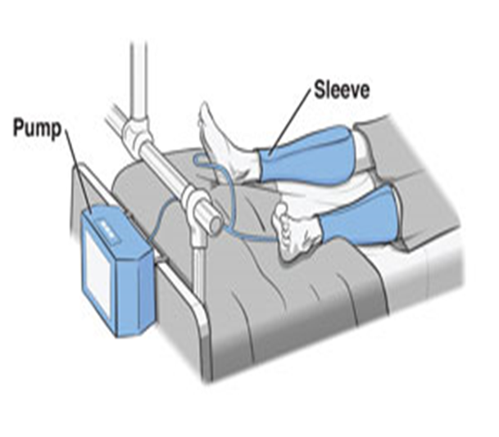
Sequential Compression Devices (SCD’s)
A Sequential Compression Device (SCD) is equipment that can assist in prevention of deep vein thrombosis (DVT). It improves blood flow in the legs. SCD’s are shaped like “sleeves” that wrap around the legs and inflate with air one at a time. This imitates walking and helps prevent blood clots. You should wear your SCD’s any time you are in bed or sitting in a chair.

Slide 19
Anticoagulation Therapy
Your surgeon will prescribe an anticoagulant (blood thinner) to help prevent blood clots
There are many different medications we use for this. The anticoagulant will begin to be administered in the hospital and will continue as prescribed by your surgeon
You will receive information and instructions on how to take this medication from your nurse before you are discharged home. It is important you take this medication as instructed

Slide 20
When you arrive on the Short Stay/Ortho Unit
You will start to eat/drink juice, jello, crackers, water, ginger ale and progress to your regular diet
We will show you how to use an incentive spirometer and encourage you to use it 10/hour
You will have your ice on your knee throughout your stay
You will begin your rehabilitation today, either with physical therapy or nursing staff helping you to the side of the bed, walking around your room and/or sitting in the recliner
Your nursing staff will have to check on you frequently the first night

Slide 21
Pain Management
Your caregiver will do everything they can to get you comfortable enough to participate in your recovery.
Caregivers will often ask you to rate your pain level on a scale of 0-10
Our goal is to always keep your pain level at a level where you are able to participate in your rehabilitation
Your pain will be managed with different medications including local nerve blocks, oral medications. Some of these medications are scheduled and given at set times and others are given as needed to help control your pain. Cold therapy will also be used.

Slide 22
Pain Management
Tylenol 1000mg (500mg tab x 2) every 8 hours
Oxycodone 5mg for breakthrough pain (Opioid)
Opioid Information
Surgeon can only prescribe a 7 day supply at discharge- must call surgeon’s office for refill- allow 2 days for refill. Don’t call on weekends, after hours or holidays
Opioids can cause constipation, nausea, dizziness- you should take laxatives and a stool softener while on opioids. Colace(stool softener), Miralax and Senna (laxatives)

Slide 23
Nerve Block
Your anesthesiologist may talk with you about placing a nerve block catheter (tiny soft tube) to help with pain relief after your surgery. The block is put in just before surgery .
The nerve block is connected to a portable pump(Ambit pump) that delivers numbing pain medication around the bundle of nerves that leads to your operative knee. Depending on the dose you need, the pump will run for 3 to 4 days.
You may still have pain with a nerve block and need to take additional pain pills as prescribed by your doctor.

Slide 24
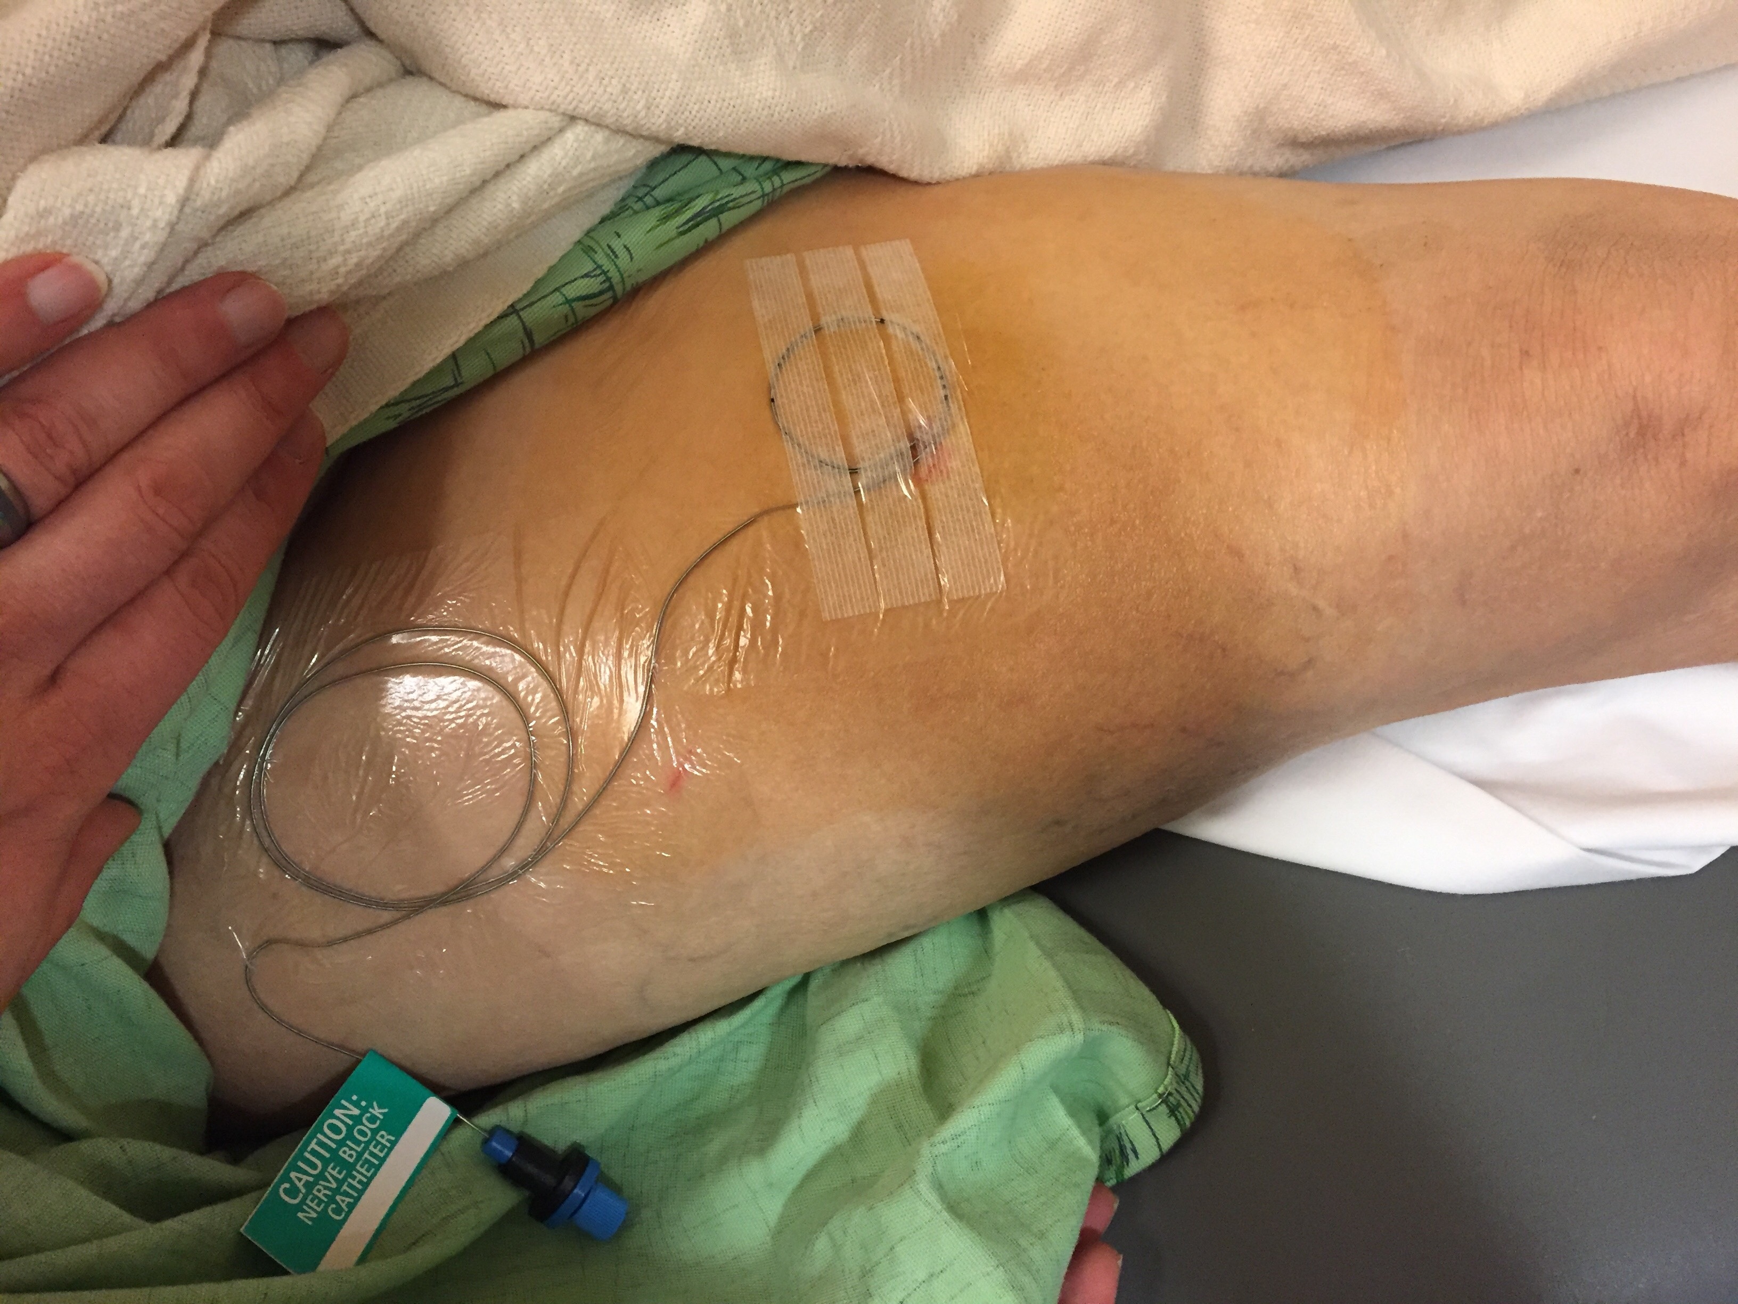
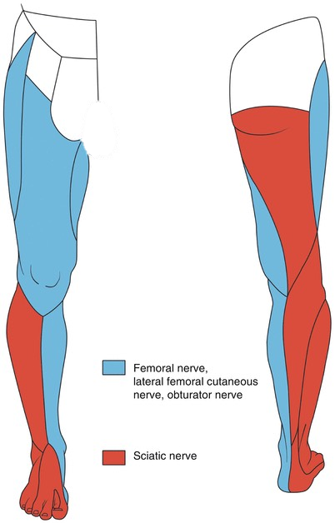
Local Nerve Block

Slide 25
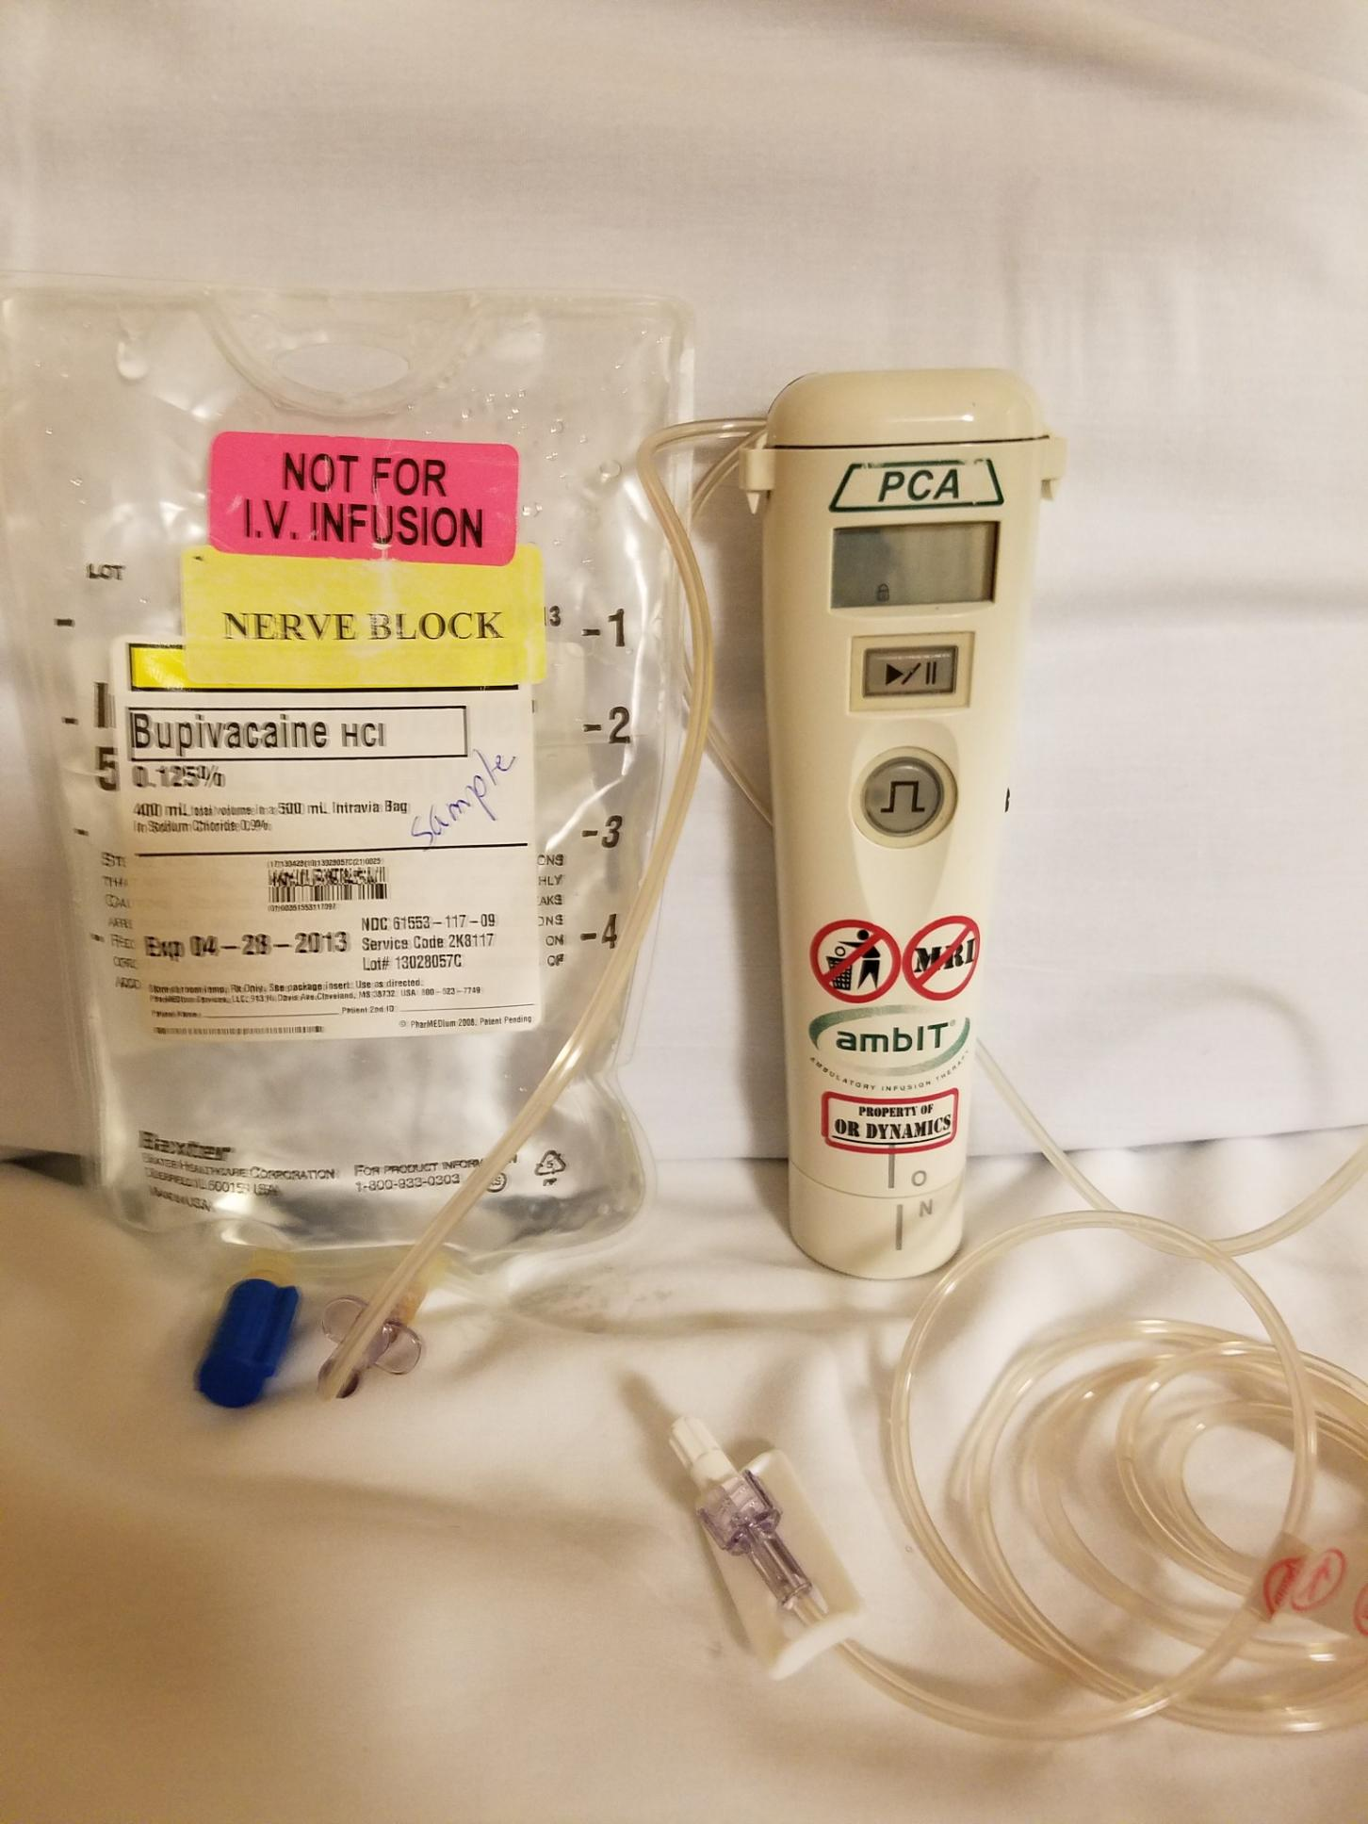
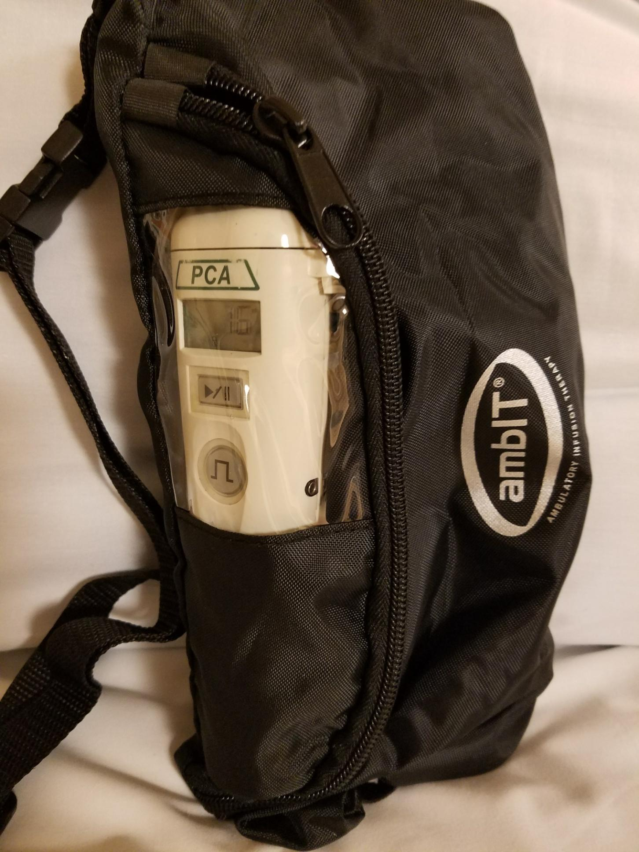
Nerve Block Equipment

Slide 26
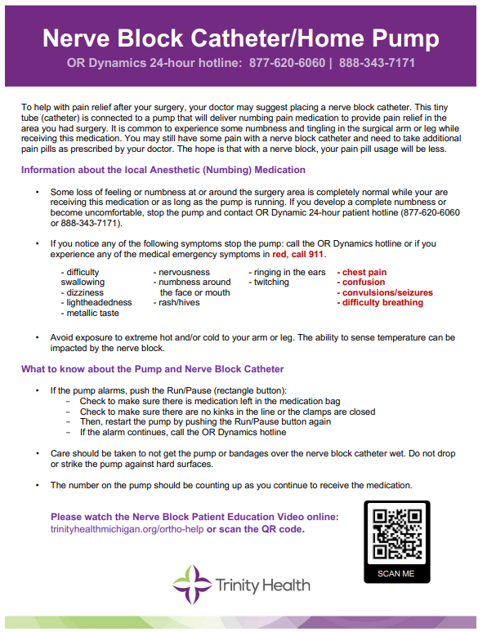
Nerve Block Education
Please read the Nerve Block Catheter/Home Pump Patient Education Guide on page 26-27 of your Knee Book
Watch the Nerve Block Patient Education Video by scanning the QR code or on the website TrinityHealthMichigan.org/ortho-help
Once you are home, a 24-hour patient hotline is available to contact for any questions or concerns.

Slide 27
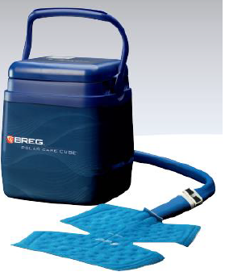
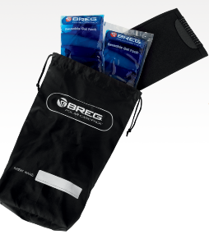
Cooling Therapy
There are many different options for Cold Therapy after surgery. It is important to use cold to help decrease pain and swelling after surgery
Cold machines, gel packs, ice in plastic bags, frozen vegetables from the grocery store
Many Insurance companies do not pay for cold therapy- your surgeons office will give a prescription for a cold machine to Lytle Medical Technologies and they will check your insurance and contact you before your surgery

Slide 28
After your Surgery
Your nurse will continue to assess your pain level and work on a plan with you to ensure it is controlled using scheduled Tylenol and opioid pain medication
A side effect of the pain medication is constipation so you will also be started on a bowel management program
Physical Therapy will work with you, helping you regain your strength. As your recovery progresses, you will get up for meals and go to the bathroom with help from our team. The physical therapy team will work with you to ensure a safe discharge home
Our discharge planners will meet with you to discuss your discharge and any equipment needs you may have

Slide 29
Discharge
Most people are ready to go home either the day of surgery or after 1 night in the hospital. You will go home when you meet your discharge goals.
We want you to go home after your surgery-not rehab
Patients recover better in their own home environment
Please make sure you arrange to have someone available to drive you home
Home physical therapy will be provided for 2 weeks and then you will go to outpatient Physical Therapy
Discharge instructions will be given to you by your nurse and prescriptions given to you which can be filled in our pharmacy, just ask your nurse how to do this

Slide 30
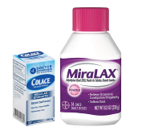
Possible complications following surgery
Blood clots – follow your surgeon’s instructions carefully to minimize this potential risk. Make sure you take your anticoagulation medication as instructed by nursing staff and continue doing your ankle exercises
Infection – follow instructions given at discharge to prevent infection. Do not remove your top dressing until day 7 after your surgery and the Sylke on day 14. Use Dyna-hex in the shower until gone and pat your incision dry. Leave open to air. Do not use any creams or lotions on your incision
Constipation – Your pain medication can make you constipated. Make sure you take laxatives (Miralax or Senna) and stool softener (Colace) following your discharge and eat a diet high in fiber and drink lots of water
Pain - Make sure you take your pain medication as instructed. Elevate your leg higher than your heart. Your leg will swell and this can add to your discomfort

Slide 31
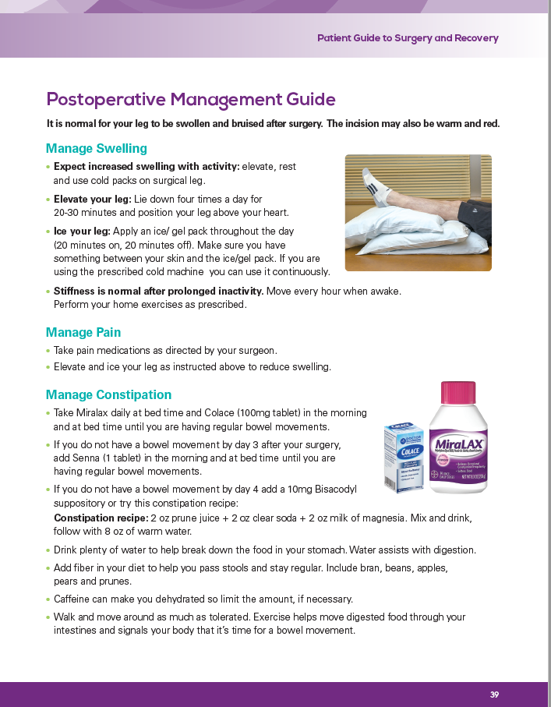
Post op Guide page 37 of your book

Slide 32
Questions?
If you have any questions about anything you have heard today, or have any concerns about your surgery please do not hesitate to contact me
Molly-Orthopedic Nurse Navigator 734-712-2392
Molly.Sieffert@Trinity-Health.org
You can leave a message and I will return your call as soon as possible
If you have urgent questions please call your orthopedic surgeons office

Slide 33
Physical Therapy

Slide 34

Pre-op Exercises
See “Pre-op exercise” pp. 18-20 of your patient guide booklet
Start with 5 reps, increase to 15 as able
We’ve targeted functional exercises
We also target your thigh muscle – quads
Do these exercises on a bed, no need to get on the floor!

Slide 35
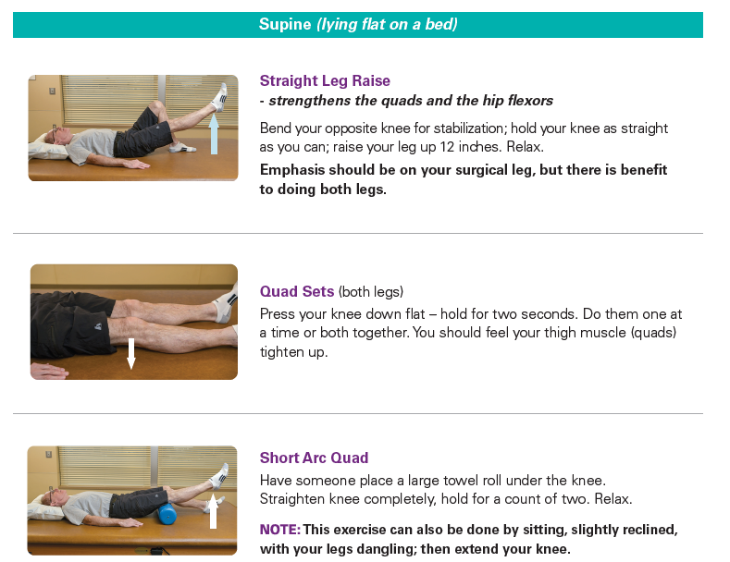
Pre-Op Exercises

Slide 36
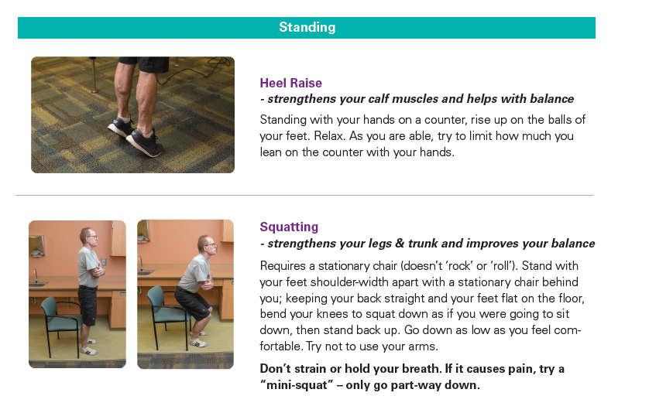

Slide 37
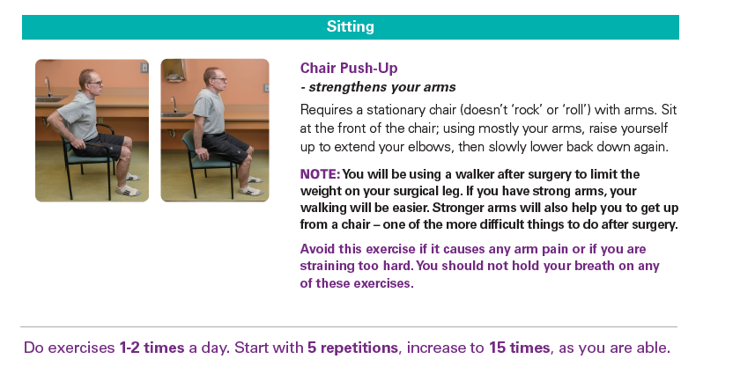

Slide 38
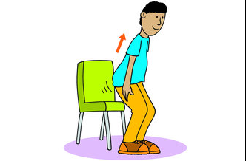
What to do before surgery
Stay mobile!
Make it a habit to interrupt your sitting every 1-2 hours especially after surgery

Slide 39
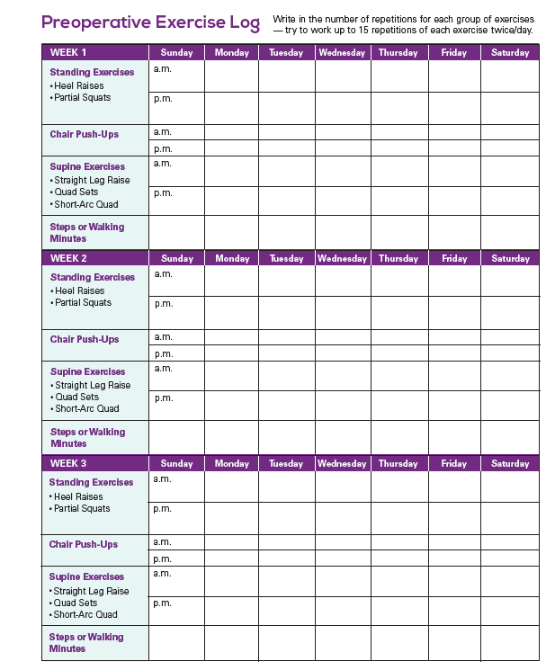
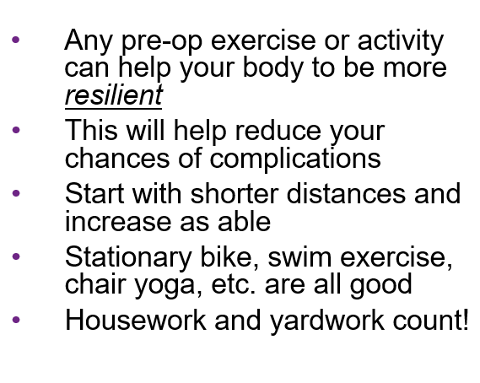
Activity/Walking Log
(Pages 20-21 in knee book)

Slide 40

Goals
Set an activity goal for after surgery
Write it down, stick it on the fridge!
For example:
Go on vacation
Start an exercise class
Walk without a walker

Slide 41
Physical Therapy in the Hospital
PT will see you . . .
  Day of surgery
  And then as needed until discharge
Therapy will include:
  Home Exercise Instruction
  How to get in & out of bed and how to get on & off the toilet
  Walking
  Practice stairs
  Family instruction

Slide 42
Walking After Surgery
Recommend a front-wheeled walker
Avoid 4-wheeled walkers for the first week
Weight-bearing as tolerated
Starting Walking Pattern:
    Move the walker forward
    Step into the walker with your surgical leg
    Bring your opposite leg forward in line with your surgical leg

Slide 43
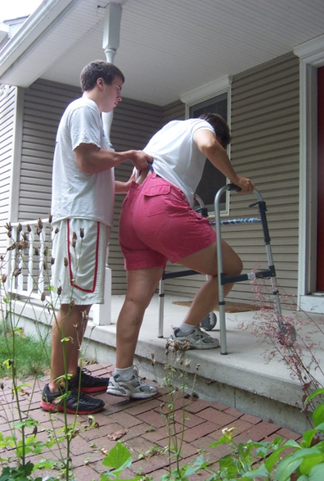
Stairs
Can the depth of your walker fit on your entry steps (as you can see in this picture)?
If so, your walker will go up first then
    Going up stairs the stronger leg goes first
    Going downstairs the weaker leg goes first
    “The good leg goes to heaven; the bad leg goes to hell”

Slide 44
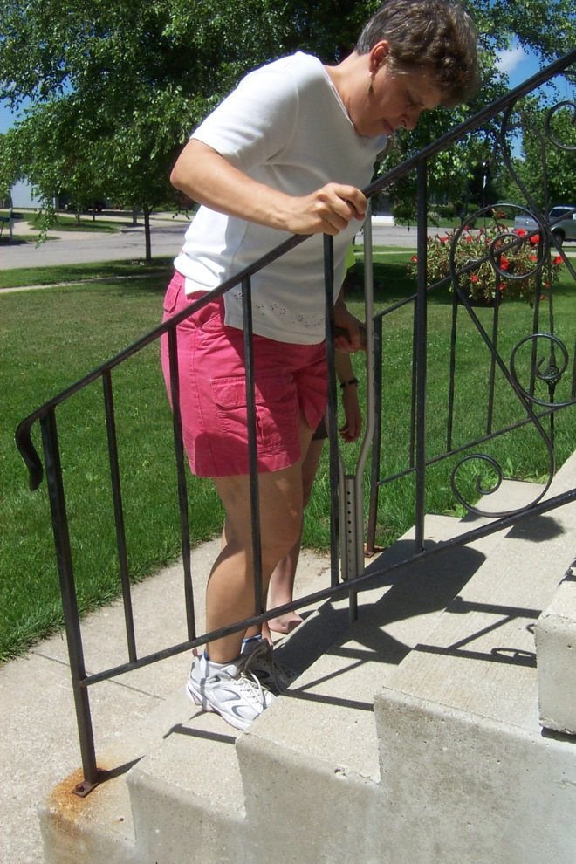
If your walker does NOT fit on each step
We strongly recommend you have a railing installed
We will practice stairs in the hospital
Using a single handrail and a crutch or cane works well
The same applies going to the second level of your home

Slide 45
Home Exercise Program
We will start you with ‘circulation exercises’
Your PT will instruct you in your home exercises
  Don’t start any exercises until we ask you to
Exercises and household walking will be your rehab for the first 2 weeks
  Gradually progress walking and activity
  Progress to using cane in your opposite hand
You may request to have home PT the first 2 weeks

Slide 46
Outpatient Physical Therapy
You can start outpatient PT after several weeks (you will need a prescription from your surgeon)
You may need a ride as you will probably not be driving when you start outpatient PT
Outpatient PT will help you get a stronger, safer, more flexible knee and get a more fluid walking pattern
You can go to Trinity Health Probility Physical Therapy or a place of your choice

Slide 47
Discharge Planning
We recommend you have someone stay with you for several days, up to a week
  It does not need to be 24/7
Don’t turn down offers for help!
  Help with meals is particularly helpful

Slide 48
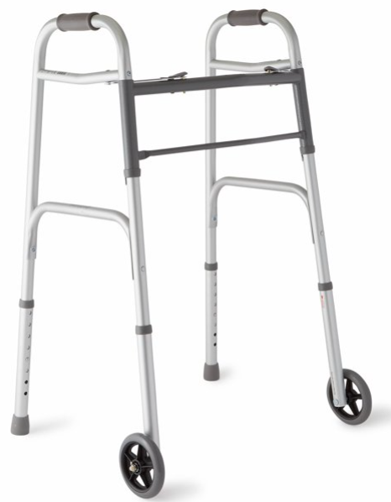
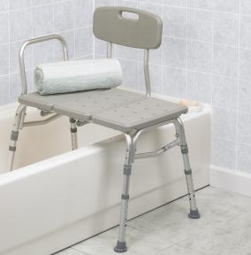
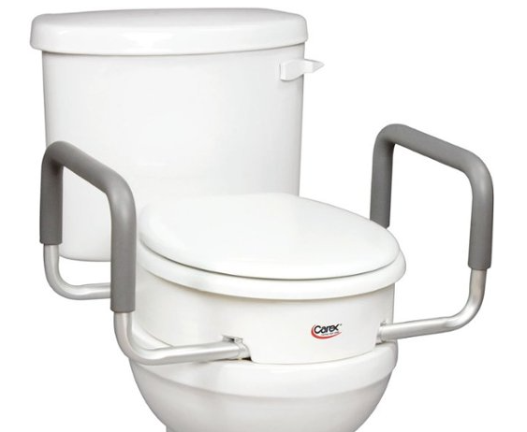
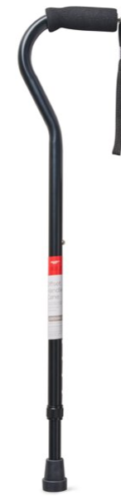
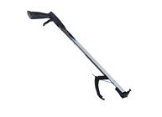
Equipment
Walker –front-wheeled
Tub transfer bench
Single crutch or cane – for stairs with a rail
Raised toilet seat – try getting off your toilet without using your surgical leg; taller people more likely to need them
Reacher – very helpful, may want to get one ahead of time

Slide 49
Where to Obtain Equipment
Medical Equipment store for prescribed equipment
Local stores for purchase-Lowes, CVS, Meijer, Walmart
Online stores for purchase- Amazon
Loan closets to borrow equipment
LOANCLOSETS.ORG/MICHIGAN
Senior centers
Church’s
VFW’s
American Legion’s

Slide 50
Summary
Pre-op exercises
Log your activity
Set an activity goal
Get a railing for your entry steps
Visit our website – trinityhealthmichigan.org/ortho-help
Arrange for help after your surgery
Plan your equipment needs

Slide 51
Thank you!
Any Questions?

