Slide 1
Total Shoulder Replacement
Pre-Surgery Class
Molly Sieffert BSN, RN
Orthopedic Nurse Navigator-Ann Arbor
Keri Massey BSN, RN
Orthopedic Nurse Navigator- Brighton/Livingston

Slide 2
Virtual Class Reminders
Microphones are automatically muted
Please type your questions in the chat box and I will answer them at the end of the class
You can find the the Shoulder Book, these slides, nerve block video and a class video on our website TrinityHealthMichigan.org/ortho-help

Slide 3
Class Objectives The purpose of this presentation is to: Help you to feel more comfortable about your upcoming hospitalization To let you know what you can do to help in your own recovery

Slide 4
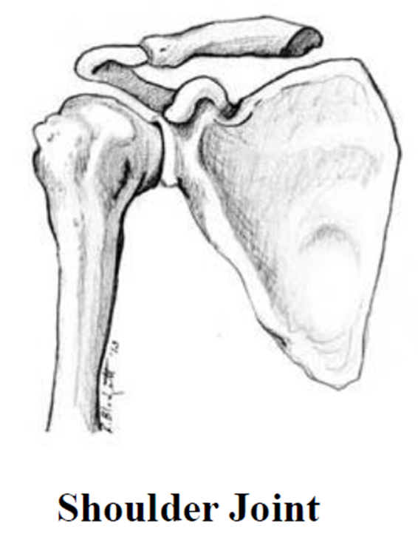
Anatomy of the Shoulder Joint
The shoulder joint is a ball and socket joint. The ball on the upper end of your arm bone (humerus) rests against your shoulder socket (glenoid). The shoulder joint is lined with a layer of smooth cartilage. This cartilage serves as a cushion and allows for smooth motion of the shoulder.

Slide 5
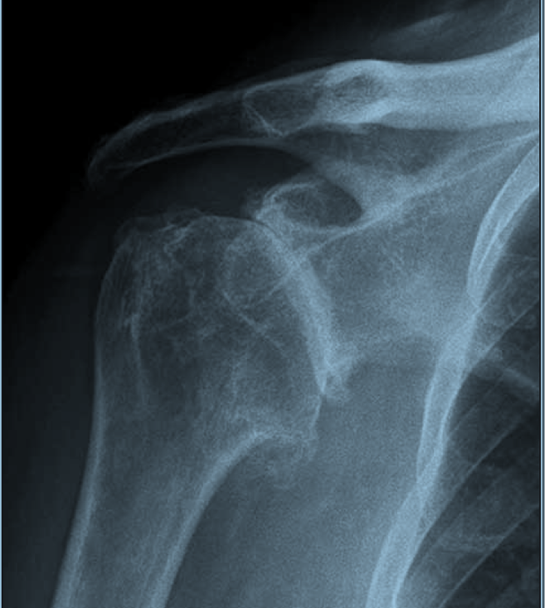
What is arthritis ?
Arthritis is a wearing away of the smooth cartilage in the shoulder joint. At some point, it may wear down to the bone. Rubbing of bone against bone causes discomfort, swelling, and stiffness. Many patients need surgery to replace the damaged joint.

Slide 6
Total Shoulder Replacement Surgery
Anatomical - In a shoulder replacement surgery the damaged joint is replaced with a new, artificial joint. The head of the humerus is removed and replaced with a metal prosthetic ball. The prosthesis continues down into the shaft of the humerus.
Reverse - For shoulders with severe rotator cuff problems, reverse shoulder replacements are Performed switching the socket and metal ball to allow different muscles to move the arm

Slide 7
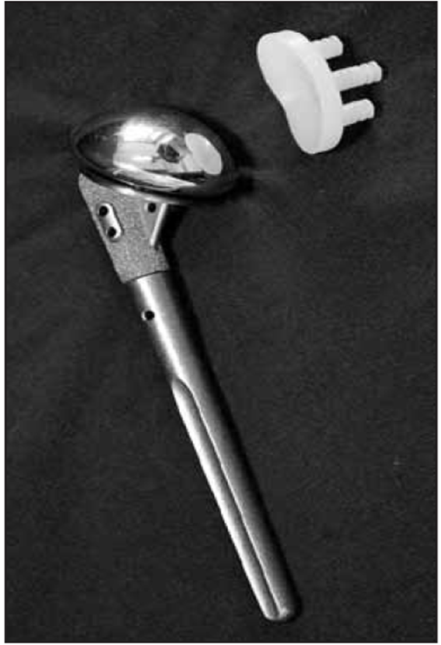
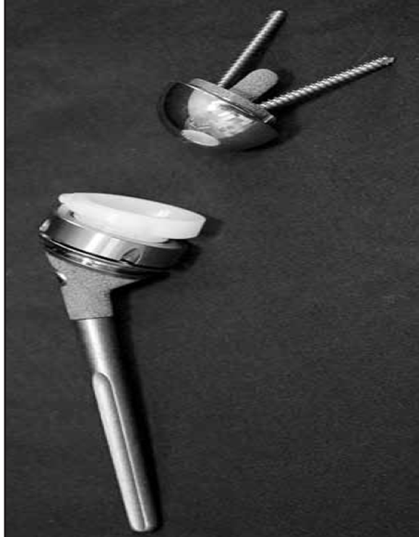
Prosthetic or artificial components

Slide 8
Tips for Preparing your Home
You and your family must consider these tips before your surgery to help make your home as safe and comfortable as possible for your return after surgery:
Check every room for tripping hazards. Remove throw rugs and secure cords
Move items in lower drawers to height to eliminate excessive bending or reaching
Plan on using a cordless phone or cell phone that can be tucked away inside a pocket
Make sure stairs have handrails that are securely fastened to walls
If you have pets, you may want to arrange boarding them first few days you are home
A chair with a firm back and arm rests is recommended, NO chairs on wheels
Prepare or purchase meals ahead of time to minimize cooking after surgery
Install night lights in bathrooms, bedrooms, and hallways
Do laundry ahead of time
Get a non-slip bathmat
Put clean linens on your bed

Slide 9
Reducing Risks and Complications
Stay active – Try to increase your activity before surgery
Healthy diet - Before your surgery, avoid foods that increase inflammation in your body. Those foods include sugar and white flour; saturated fats from red and organ meat; trans fats from commercially baked cookies, cakes and pastries; and alcohol. Aim for fresh foods, including fresh fruits, vegetables and nuts (see the Improving Your Nutrition handout- page 11 in your book)
Manage diabetes – see your PCP if needed
Reduce, eliminate tobacco. Smoking increases your risk of developing wound infection so we encourage you to try to stop before your surgery 1-800-Quit-Now can offer free advice
Reduce, eliminate alcohol. Hazardous alcohol use (3 or more drinks per day) can increase your risk of postoperative infections, cardiopulmonary complications and bleeding risk

Slide 10
Prevent Surgical Site Infection
Dental work – must be completed 1 week prior to surgery and delayed for 3 months after your surgery- you will require antibiotics before dental work after surgery
Hand washing – Good hand hygiene is essential. Encourage your family and friends to utilize an antibacterial cleanser and to always wash their hands to prevent spread of infection
Preoperative nasal swab
Use the wipes that you were given in class or at your physical on the evening before surgery. Read the instructions very carefully. Do not use them on your face or private area.
In pre-op you will receive an intra nasal treatment to help prevent postoperative infection
Optifoam AG+ Dressing

Slide 11
Prevent Surgical Site Infection
Incision care
Remove the silver dressing 7 days after surgery
Leave incision open to air
Use antibacterial body wash or a new bar of soap (Dial) to shower
Do not submerge incision in water
Do not put lotion or cream on your incision
Do not touch your incision

Slide 12
What to Bring with You
If you have Advance Directives please bring them with you
Personal care items
Slippers (that cover your whole foot) – your leg/foot will be swollen following surgery so make sure they are not tight
Please do not bring your own pillow
If you use a CPAP machine at home bring it with you, we have distilled water in the hospital for you to use.
Driver’s license, Insurance Cards and a check or credit card to pay for home medical equipment

Slide 13
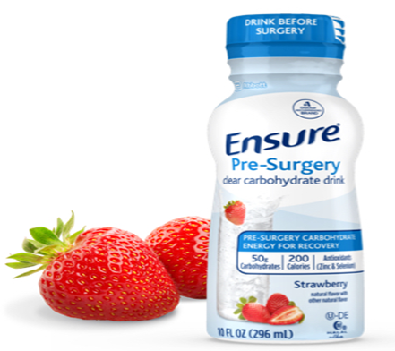
Enhanced Recovery Program
Ensure Pre-Surgery clear nutrition drink is a carbohydrate rich beverage with added supplements that you will drink in the morning on the day of your surgery
Use of Ensure Pre-Surgery Improves:
Comfort
Hydration
Hunger
Thirst

Slide 14
Enhanced Recovery Program
Ensure Pre-Surgery is available for purchase for approx. $4 for 1 bottle at the following locations
Reichert Health Building Pharmacy (ask at counter)
Brighton Health Care Center -Joes Java
Livingston Hospital -Joes Java
Chelsea Hospital -Joes Java
You will need to purchase 1 bottle
If you have Diabetes, Do not Drink Ensure Pre- Surgery

Slide 15
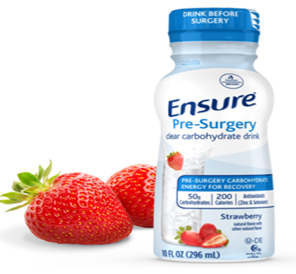
Ensure Pre-Surgery- When to Drink
Finish drinking your Ensure Pre-Surgery 2 hours before your surgery time
If you have diabetes, do not drink the Ensure
Pre-Surgery. You will be given different
instructions at your pre admission
appointment

Slide 16
Pain Management
Your caregiver will do everything they can to get you comfortable enough to participate in your recovery.
Caregivers will often ask you to rate your pain level on a scale of 0-10
Our goal is to always keep your pain level at a level where you are able to participate in your rehabilitation
Your pain will be managed with different medications including local nerve blocks, oral medications. Some of these medications are scheduled and given at set times and others are given as needed to help control your pain. Cold therapy will also be used.

Slide 17
Pain Management
Tylenol 1000mg (500mg tab x 2) every 8 hours
Oxycodone 5mg for breakthrough pain (Opioid)
Opioid Information
Surgeon can only prescribe a 7 day supply at discharge- must call surgeon’s office for refill- allow 2 days for refill. Don’t call on weekends, after hours or holidays
Opioids can cause constipation, nausea, dizziness- you should take laxatives and a stool softener while on opioids. Colace(stool softener), Miralax and Senna (laxatives)

Slide 18
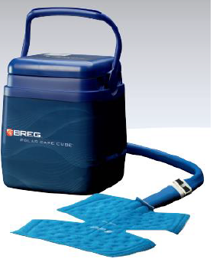
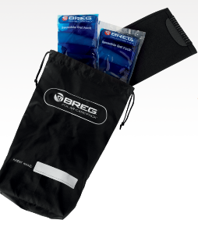
Cooling Therapy
There are many different options for Cold Therapy after surgery. It is important to use cold to help decrease pain and swelling after surgery
Cold machines, gel packs, ice in plastic bags, frozen vegetables from the grocery store are all good options
Many Insurance companies do not pay for cold therapy- your surgeons office will give a prescription for a cold machine to Lytle Medical Technologies and they will check your insurance and contact you before your surgery

Slide 19
Nerve Block
Your anesthesiologist may talk with you about placing a nerve block catheter (tiny soft tube) to help with pain relief after your surgery. The block is put in just before surgery .
The nerve block is connected to a portable pump(Ambit pump) that delivers numbing pain medication around the bundle of nerves that leads to your operative shoulder and arm. Depending on the dose you need, the pump will run for 3 to 4 days.
You may still have pain with a nerve block and need to take additional pain pills as prescribed by your doctor.

Slide 20
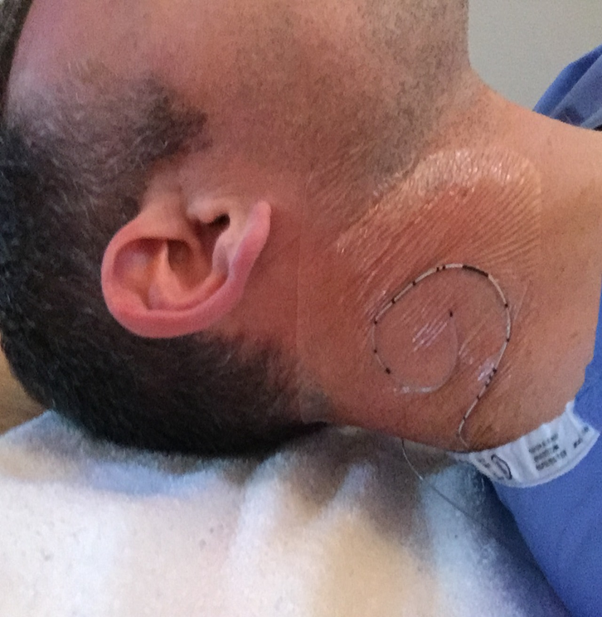
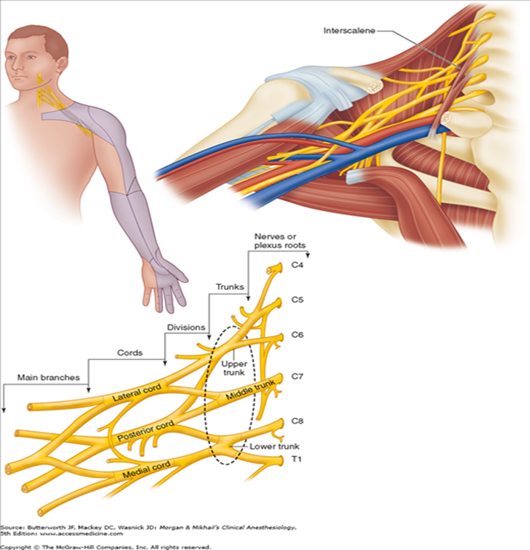
Nerve Block Placement

Slide 21
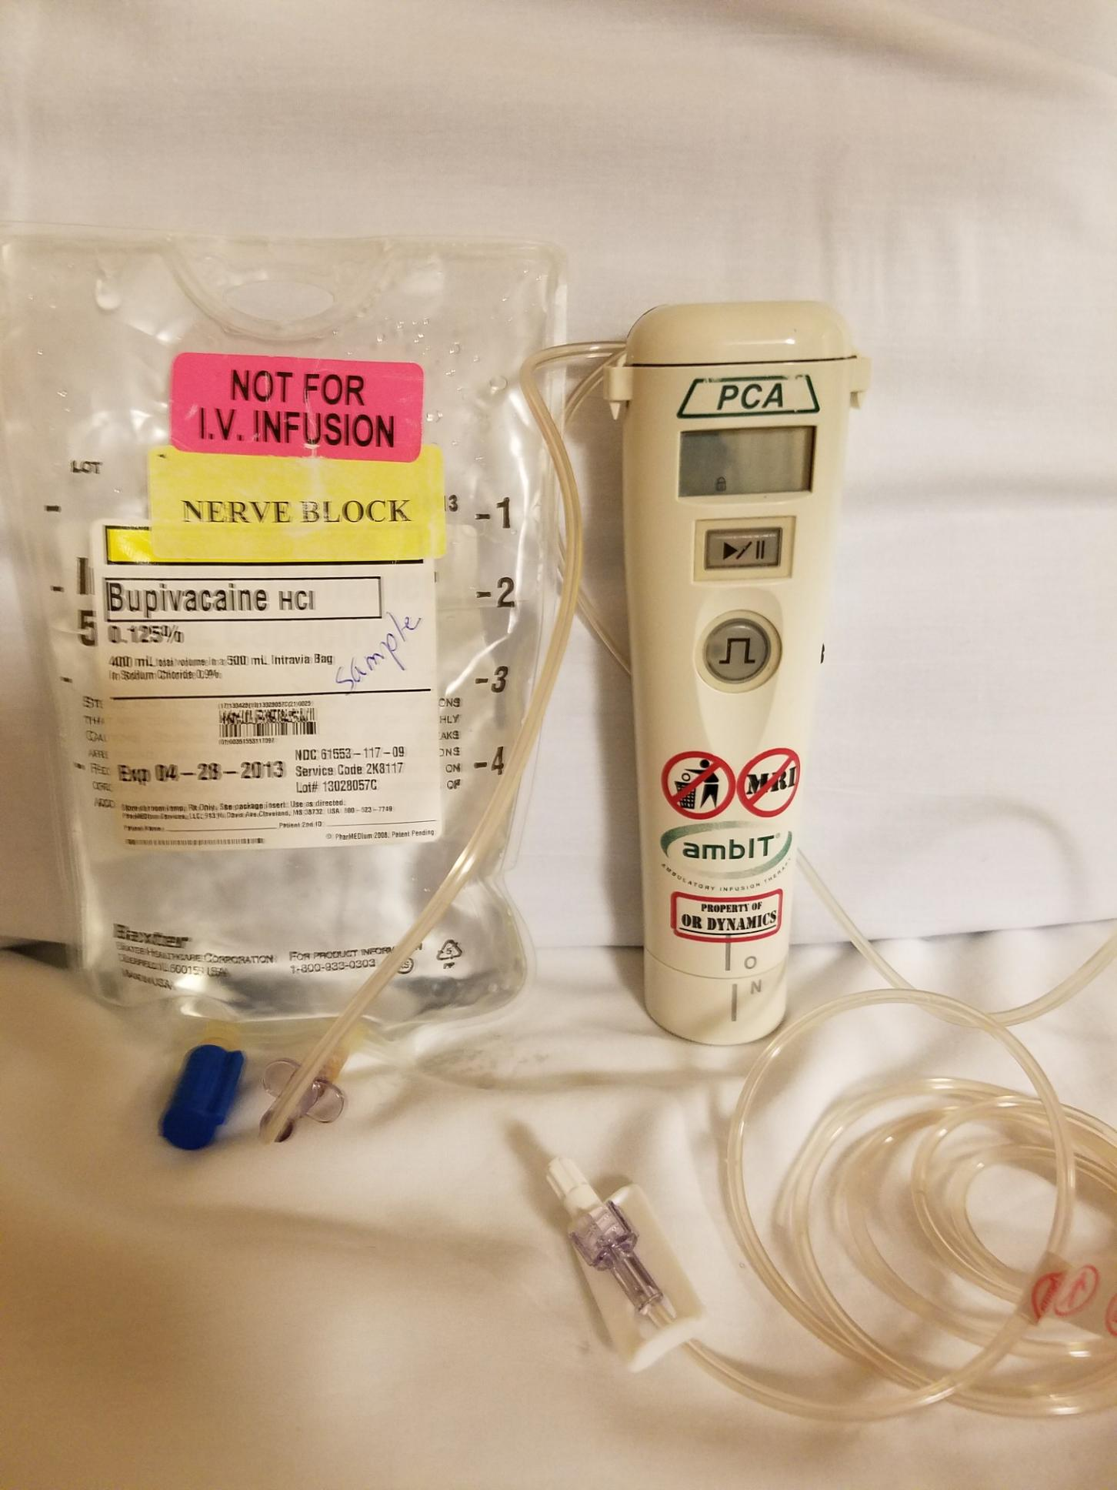
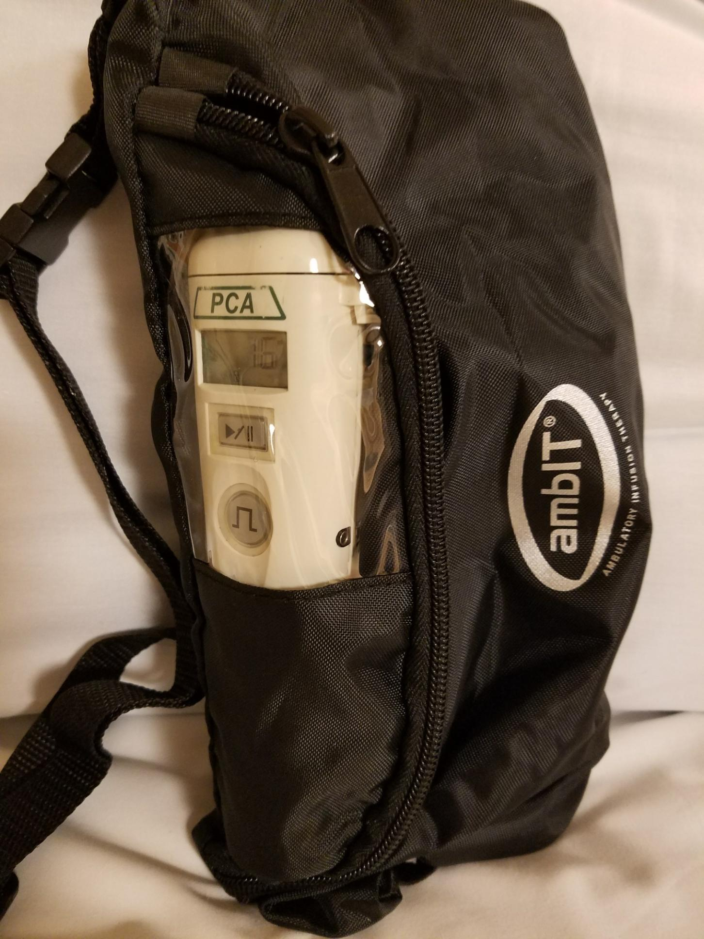
Nerve Block Equipment

Slide 22
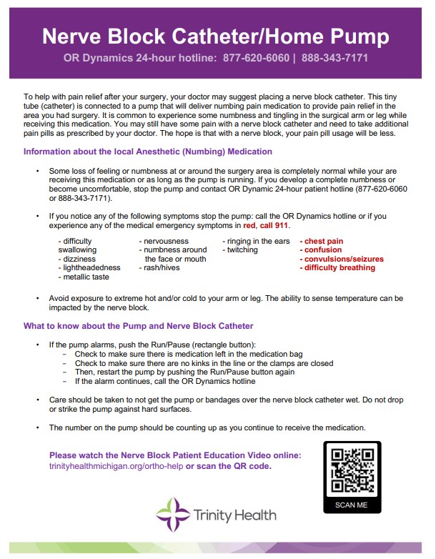
Nerve Block Education
Please read the Nerve Block Catheter/Home Pump Patient Education Guide
Watch the Nerve Block Patient Education Video on the website trinityhealthmichigan.org/ortho-help
Once you are home, a 24-hour patient hotline is available to contact for any questions or concerns.

Slide 23
Surgery and Postoperative Recovery

Slide 24
Day of Surgery
Meet anesthesiologist to discuss options for anesthesia
Surgery will take between 1-3 hours and the patient will remain in the recovery room for 1-2 hours so from the beginning of the surgery to arriving on the unit may be up to 4 hours

Slide 25
Recovery Room
You will wake up after your surgery in the recovery room.
Your nurse will ask how your pain is on the pain scale of 0-10, 0 no pain, 10 worst pain imagined
When you wake up you may have a urinary catheter to drain urine, a dressing over your incision, sequential compression devices (SCD’s) on your legs, nerve block pump, oxygen in your nose and IV fluids connected to an IV in your arm

Slide 26
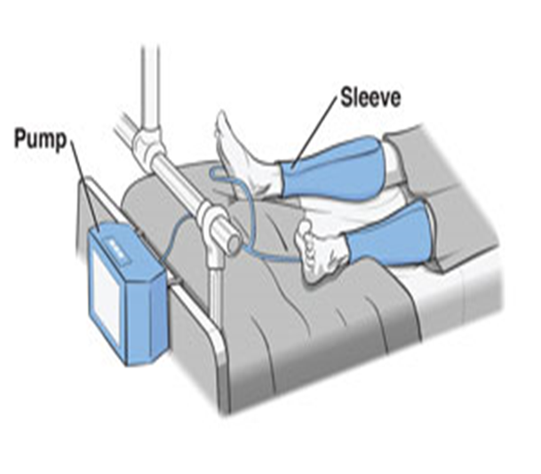
Sequential Compression Devices (SCD’s)
A Sequential Compression Device (SCD) is equipment that can assist in prevention of deep vein thrombosis (DVT). It improves blood flow in the legs. SCD’s are shaped like “sleeves” that wrap around the legs and inflate with air one at a time. This imitates walking and helps prevent blood clots. You should wear your SCD’s any time you are in bed or sitting in a chair.

Slide 27
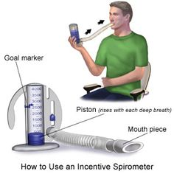
Incentive Spirometer Use your incentive spirometer throughout your hospital stay. Please take it home with you after discharge and continue to use it for 2 weeks.
Sit in an upright position
Inhale slowly and deeply to raise the indicator
When you can’t breathe in any longer take out mouthpiece and hold breath for 3-5 seconds
Exhale and repeat 10 times an hour

Slide 28
What to Expect After your Shoulder Replacement
It is a good idea to have a family member or friend stay with you in case you need any help the first day or two.
If your surgeon ordered a sling for home use, wear as directed.
Washing/Dressing – You can take your sling off to wash. You may shower after removal of the nerve block pump. Wear easy to put on clothes (clothes that open in the front) -dress your operated arm first.
Grooming – Before surgery, pay attention to your daily grooming habits. Keep in mind that you will not be able to use your operated arm for chores such as brushing your teeth, flossing or hair styling. A disposable electric toothbrush, pre-strung flossers and a low-maintenance haircut may help out
Toileting - you will need to use only your non-operated arm for wiping yourself after using the toilet. If your surgery is on the arm you are used to using, you will need to practice using your other hand before coming in for surgery.

Slide 29
What to Expect After your Shoulder Replacement
Household chores – Avoid lifting anything heavier than a glass of water with your operated arm and nothing heavy with your non-operated arm. Housework will also need to go on hold until after your first post-op visit. When climbing stairs, hold the railing with your non-operated arm.
You may activate metal detectors in airports
Limit your car rides to short trips. Do not drive until your doctor authorizes

Slide 30
Mobility
Therapy will be prescribed per your surgeon’s recommendation-usually 2 weeks after surgery
Avoid reaching out to the side
Avoid turning the arm in or putting your hand across the body
Avoid placing your arm in any extreme position, such as straight out to the side or behind your body
Do not use the arm to push yourself up in bed or from a chair because this requires forceful contraction of muscles
Do not lift anything heavier than a glass of water, until allowed by your surgeon
Increase your walking every day. It is important to get up every hour when you are awake to prevent blood clots.

Slide 31
Home Activity Preparation
Practice these daily tasks before your surgery without using the arm you will be having surgery on
Getting in and out of bed
Getting up and down from a chair
Getting dressed
Going to the bathroom
Bathing

Slide 32
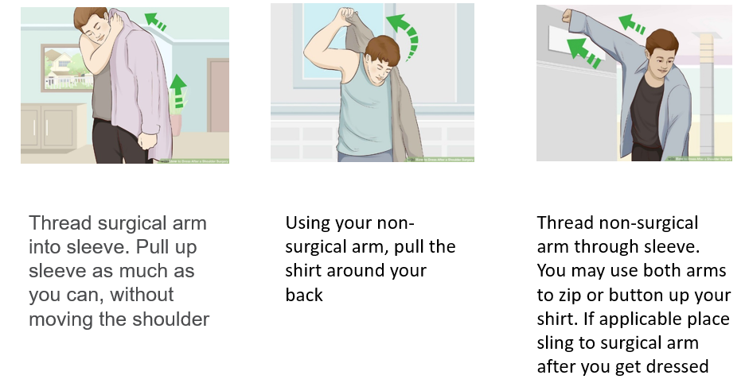
Upper Body: Dressing Button-Up Shirt

Slide 33
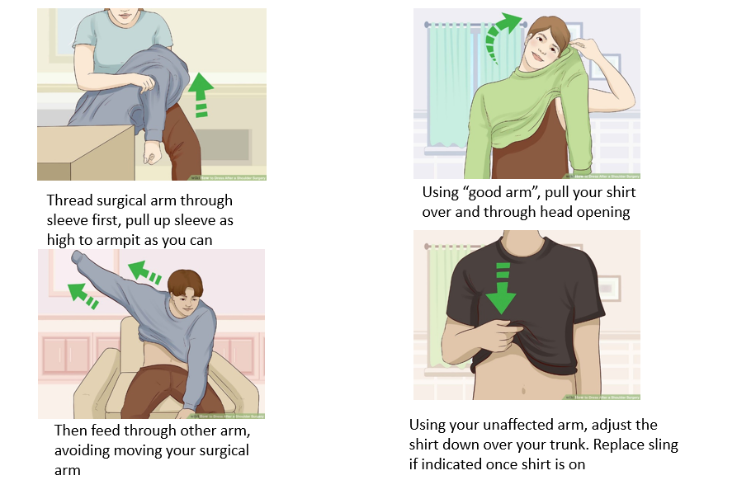
Upper Body Dressing: Pull over shirt

Slide 34
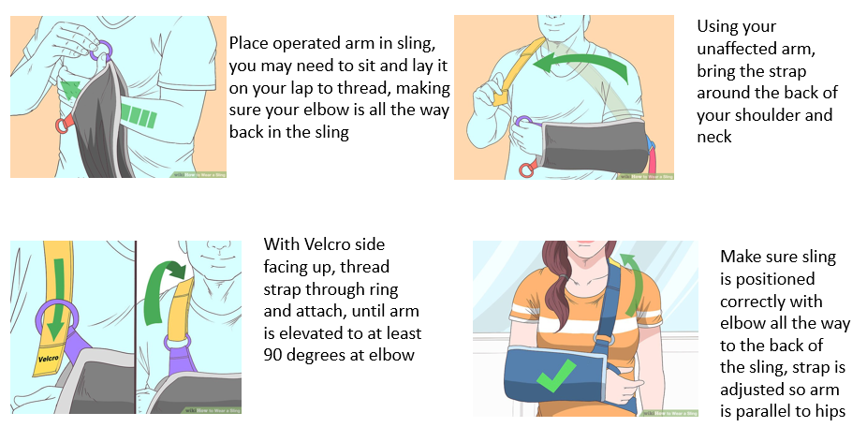
Managing a Sling

Slide 35
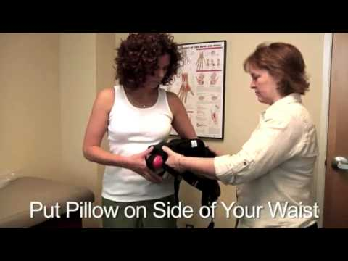
DonJoy - UltraSling

Slide 36
After Discharge from the Hospital
You are encouraged to return to your normal eating and sleeping patterns as soon as possible- sleeping during the day will make it difficult to sleep at night.
You might have less of an appetite for a while. Be sure to drink plenty of fluids.
Your energy level may be less than usual for a few weeks after surgery.
Constipation may result from pain medication. Use a stool softener (Colace) or laxative (Senna or Miralax) if needed.
You are at risk to fall. When using a sling your center of balance is altered. Therefore, take precautions not to fall.
You may find it easier to sleep on your back for comfort with a small pillow under your elbow for support. Lazy boy chairs are also a good option.
Your arm is going to be swollen and bruised. If your hand/forearm swells, elevate your hand above your elbow with a pillow keeping your elbow at your side against your body.

Slide 37
Possible complications following surgery
Blood clots –Take your anticoagulation medication as instructed. Perform ankle pumps while in the chair and bed. Use SCD’s while in bed/chair. Call your doctor for pain, redness, warmth or swelling in your calf. If you have chest pain, shortness of breath, or confusion- call 911
Infection – Follow instructions given at discharge to prevent infection. Do not use any creams or lotions on your incision. Call your doctor for increased drainage from your incision, redness moving away from the incision line, sudden increased pain at the incision and fever greater than 101.5
Constipation – Your pain medication can make you constipated. Make sure you take laxatives (Miralax or Senna) and stool softeners (Colace) following your discharge and eat a diet high in fiber and drink lots of water.
Pain - Make sure you take your pain medication as instructed. Use ice bag/cold machine

Slide 38
Discharge
Please make sure you arrange to have someone available to drive you home
Our discharge planners will meet with you if you have any discharge or equipment needs
We recommend that you have someone to help you at home for several days, up to a week--it does not need to be 24/7
Don’t turn down offers for help! Help with meals is particularly helpful
Discharge instructions will be given to you by your nurse. Prescriptions can be filled in our pharmacy if you wish, just ask your nurse how to do this

Slide 39
Questions?
If you have any questions about anything you have heard today, or have any concerns please do not hesitate to contact me
If your surgery is in Ann Arbor- contact
Molly-Orthopedic Nurse Navigator 734-712-2392
Molly.Sieffert@Trinity-Health.org
If your surgery is in Brighton- contact
Keri-Orthopedic Nurse Navigator 810-844-7614
Keri.Massey@Trinity-Health.org
If you have urgent questions, please call your orthopedic surgeons office

Slide 40
Enjoy Your New Shoulder! Your preparation and hard work will pay off You will be very glad you had the surgery We wish you well!

